Slide 1
Model evaluation & selection: super-resolution
Group1, project3
Team members
Min Jin
Yukun Pei (Presenter)
Atishay Sehgal
Wenting Yu
Lingyi Zhao

Slide 2
Project goals:
Model Selection
Model Evaluation
Model of feature selection:
Random points + Patching + 0 padding
High frequency filtering + Symmetric padding?
Model of super-resolution:
Basic interpolation(no ml)?
Baseline model GBM
Advanced model XGboost
Metrics?
Time of feature extraction?
Time of cross-validation(tuning parameters)?
Time of super-resolution?
Accuracy of training samples?
Accuracy of testing samples?

Slide 3
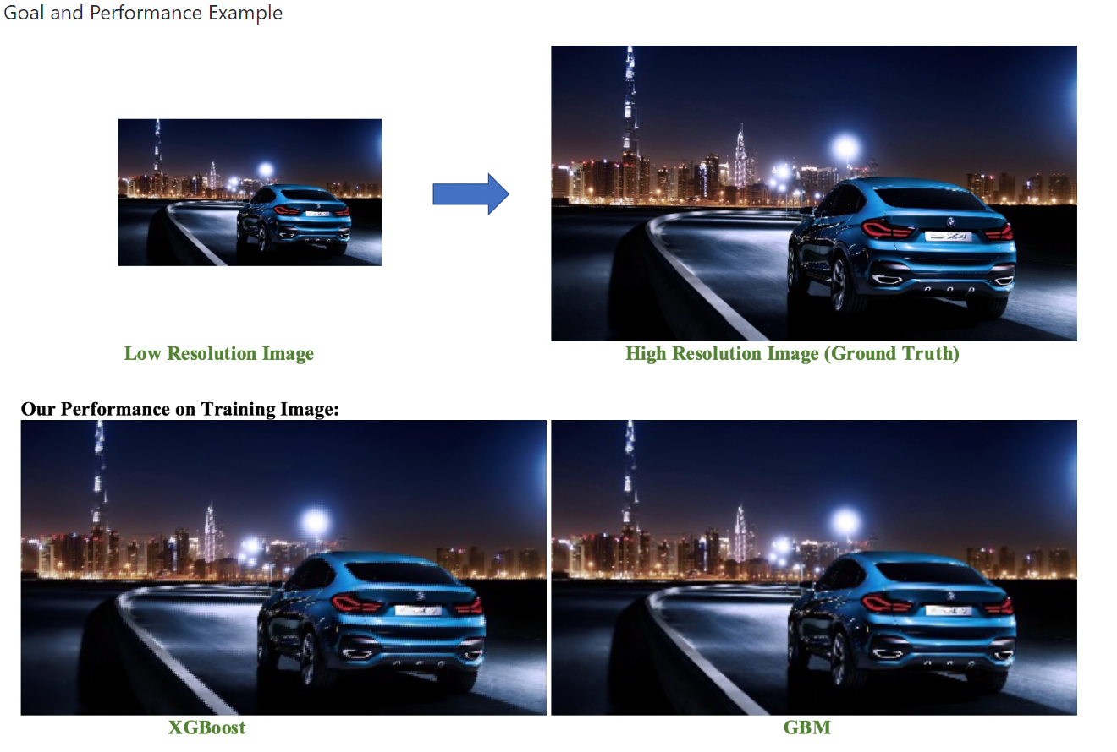
Train example

Slide 4
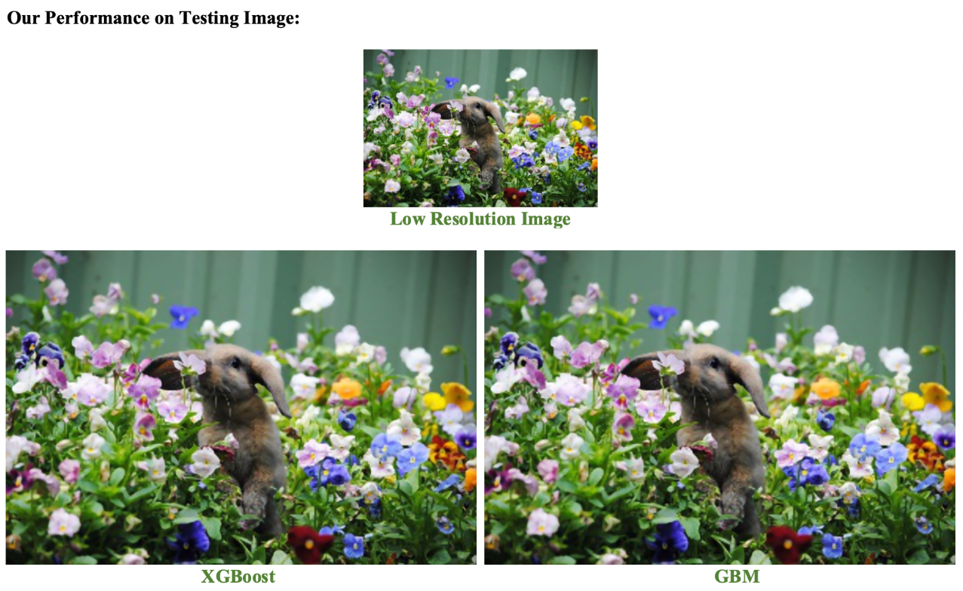
Test example

Slide 5
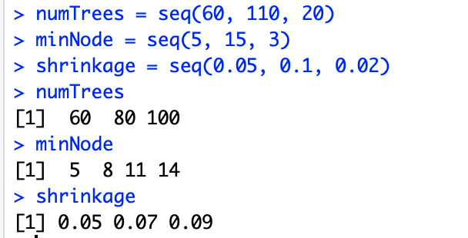
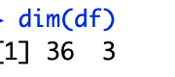
Baseline model: GBM ntree = 1 with decision stump
Tuning parameter
Parameters
Data.frame

Slide 6
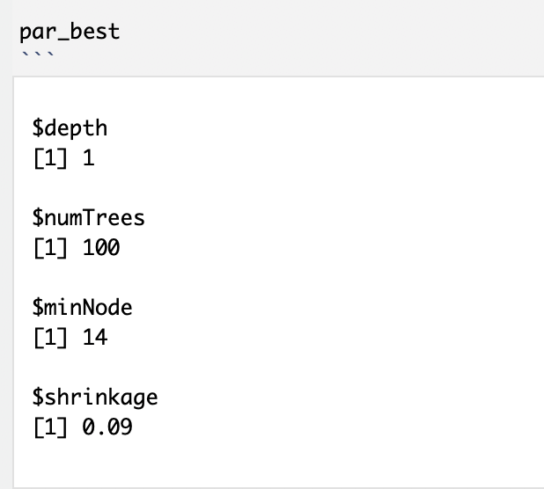
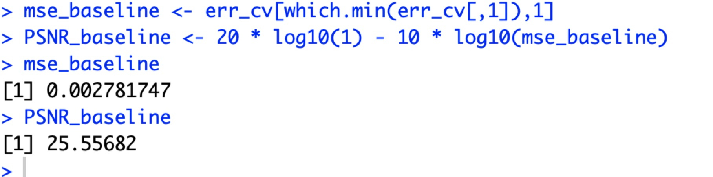
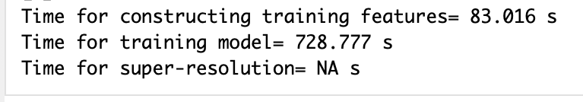
Baseline model: GBM ntree = 1 with decision stump
Final model

Slide 7
Advanced model: Xgboost
We Tried:
We Used:
Nrounds=c(5, 9, 14)
Eta=0.6
Max.depth= c(2, 5, 8)
Nrounds=100, 200, 300
Eta=(0.01, 0.1, 0.2, 0.3, 0.4, 0.5, 0.6 0.7)
Max.depth= c(2, 5, 7, 9)
Problems:
Nrounds too large will need long time to run and result is still not good.
Max.depth too large will result overfit

Slide 8
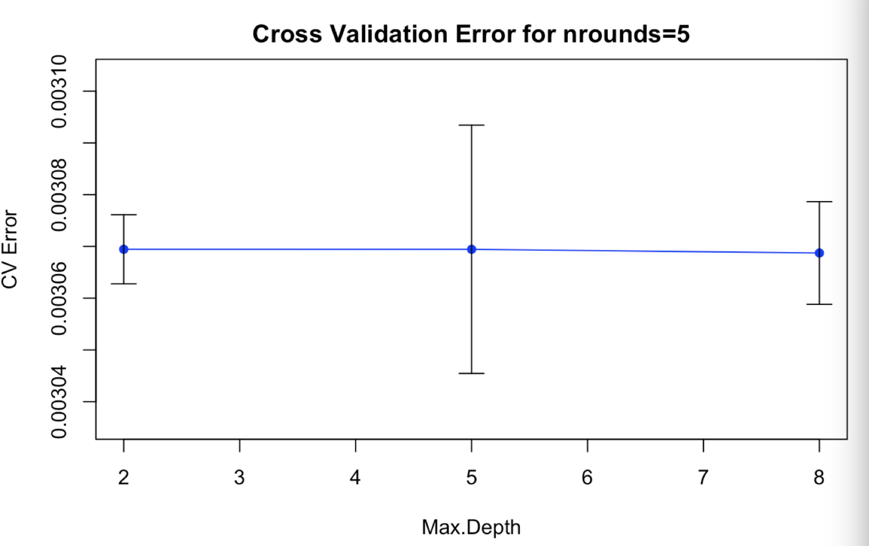
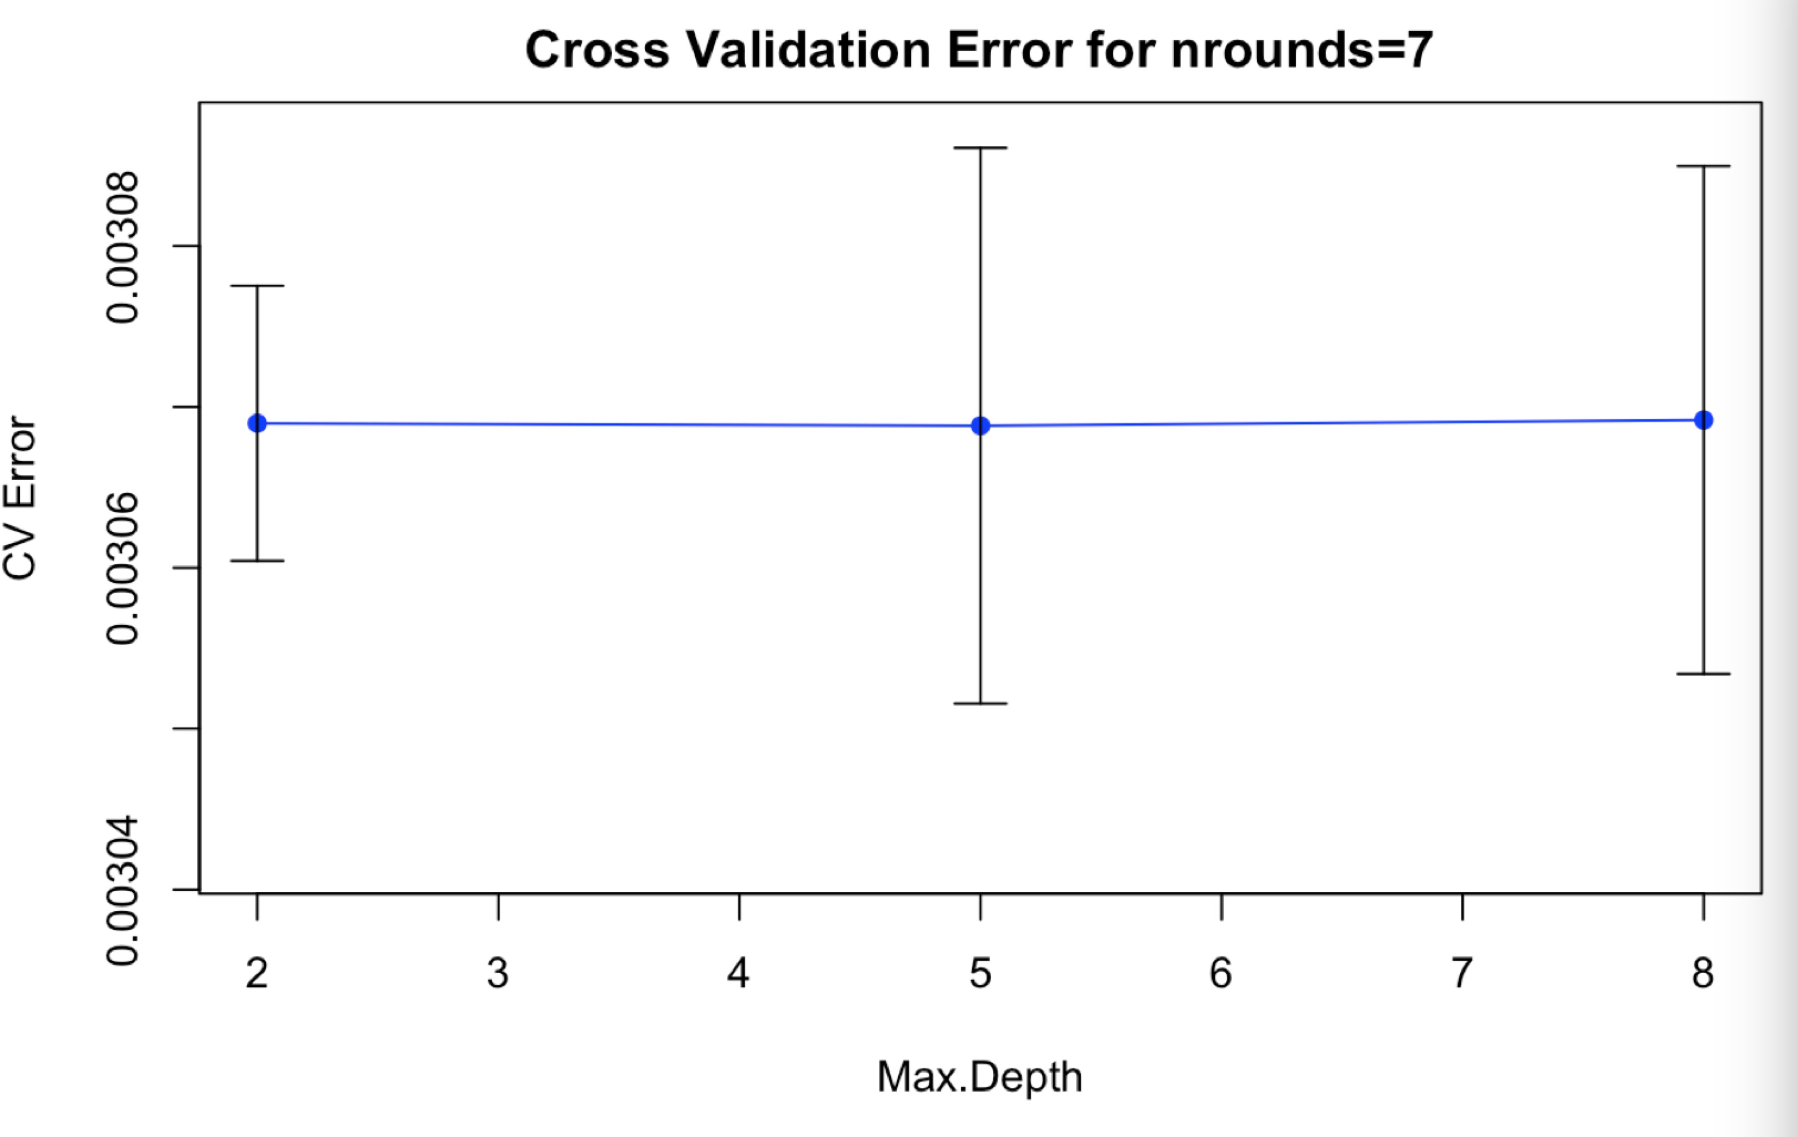
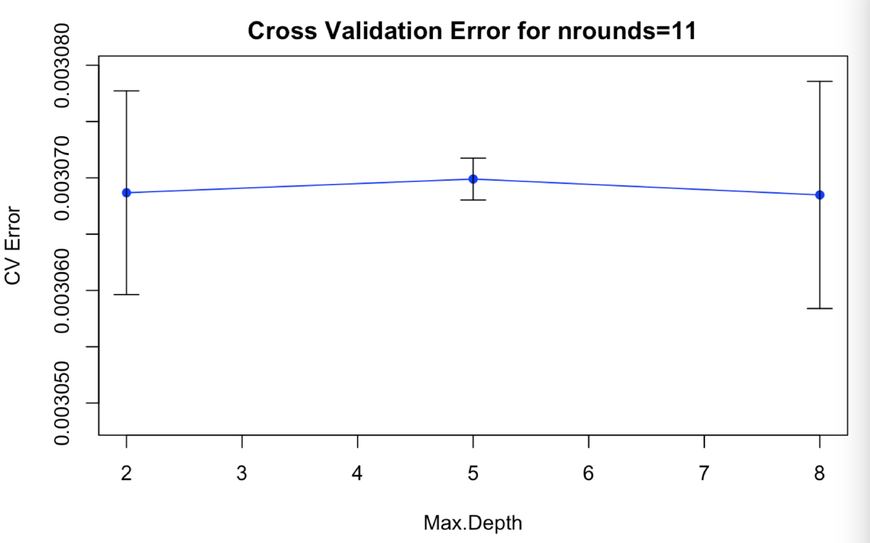
Advanced model: Xgboost

Slide 9
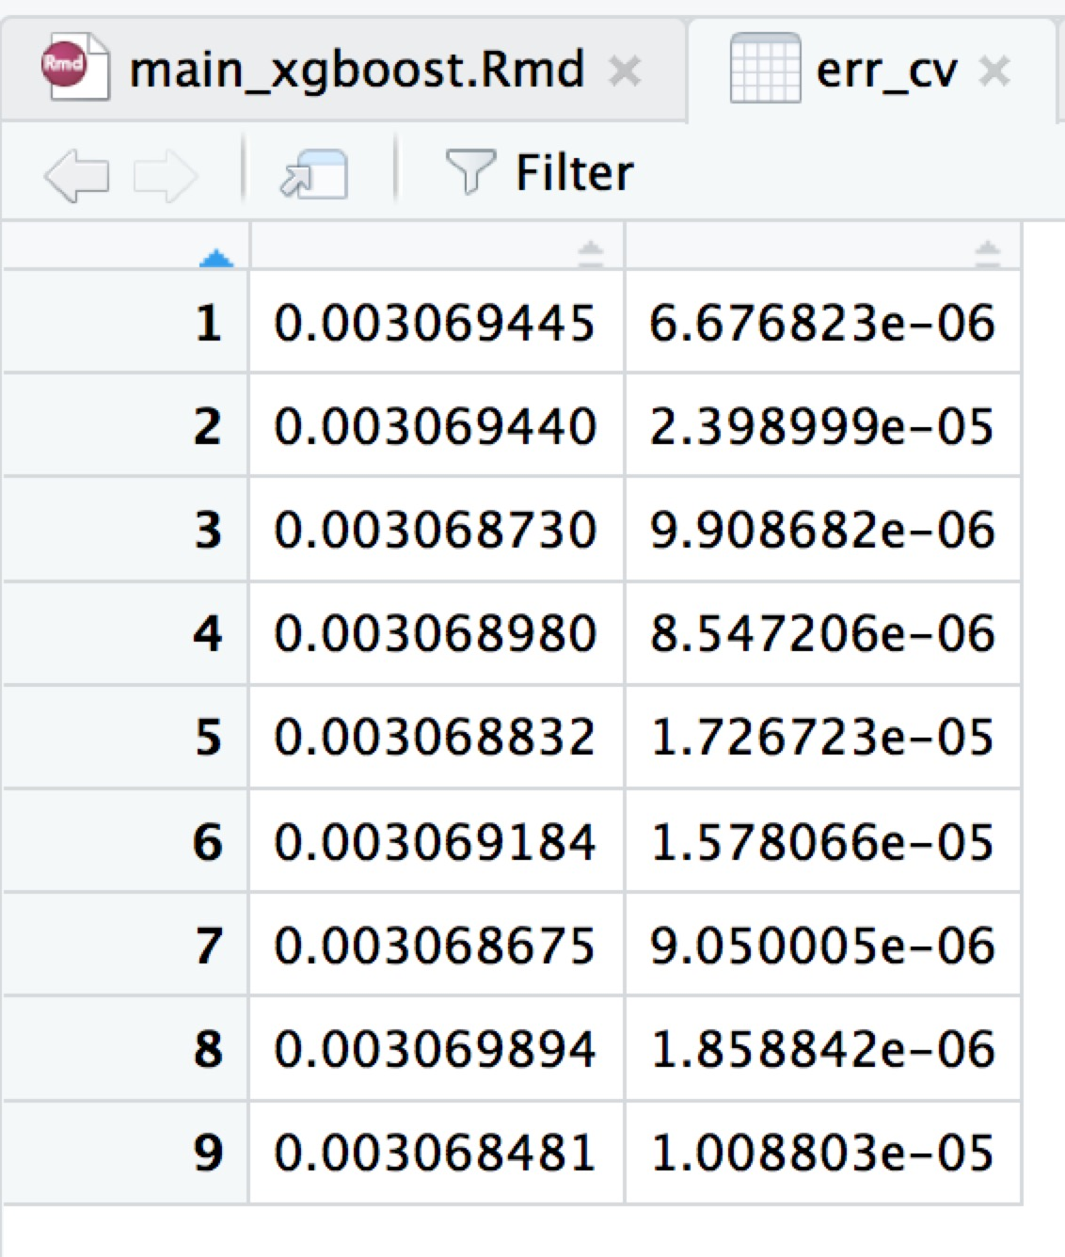
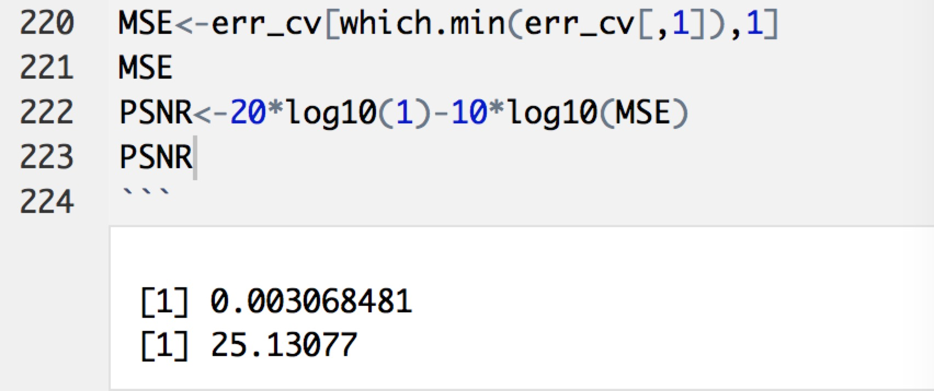
Advanced model: Xgboost
Best Parameters are:
Nrounds=14, eta=0.6, Max.depth=8

Slide 10
Comparison: Advanced vs. baseline
XGBoost
GBM with decision stump
Accuracy: good(MSE ~ 0.0030)
Time consumption: fast(40min)
Accuracy: slightly better(MSE ~ 0.0027)
Time consumption: low(3h)
Our decision: XGBoost with parameter:Nrounds=14, eta=0.6, Max.depth=8, considering time and electricity cost

Slide 11

Thanks!

